Slide 1
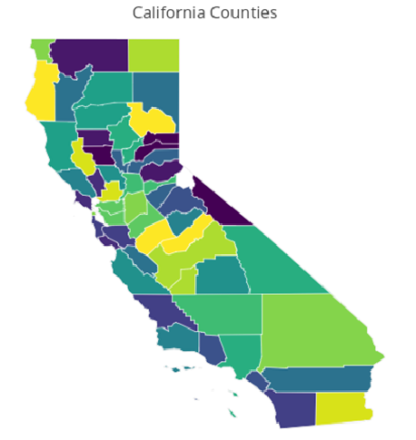
Data Collection Using EPA API
(https://aqs.epa.gov/api)
Nested For Loop
County code
Year
001
003
005
007
…
115
[ DataFrame ]
Parameter of
interest
2011
2012
2013
2014
2015
2016
2017
[ DF1,
DF2,
DF3,
…,
DFi ]
CO
Ozone
PM2.5
PM10
Wind Speed
Temp
Humidity
[ Master DF ]
~ 3.5 x 10^6 Rows
~ 3 hours of querying
Notes:
Tropospheric ozone is a secondary pollutant, it is not emitted directly but instead is produced photochemically in the troposphere by its precursors such as reactive nitrogen oxide (NOx), CO, CH4 and VOC’s. Life time of an ozone molecule in the troposphere varies according to the photochemical activity ( a mean tropospheric life time is ~22days). Ozone has a longer life time in the free and cold troposphere than warmer boundary layer.
difference between stratospheric and tropospheric ozone generation is in the source of atomic O
for solar radiation with a wavelength of less than 242 nm:
O₂ + hv  O + O
photochemical production of O₃ in troposphere tied to NO_{x} (NO + NO₂)
for wavelengths less than 424 nm:
NO₂ + hv  NO + O
but NO will react with O₃
NO + O₃  NO₂
presence of peroxy radicals, from the oxidation of hydrocarbons, disturbs O₃-NO-NO₂ cycle
NO + HO₂·  NO₂ + OH·
NO + RO₂·  NO₂ + RO·
leads to net production of ozone
The ozone molecule has four resonance structure which imparts or confer a slight polarity to the ozone molecule (0.53D).
The bond length 1.272A is intermediate b/w double bond 1.21A and single bond (H-O) 1.47A {angstroms (A)}.
Protective shield in the stratosphere
Strong oxidant
Secondary pollutant in the troposphere
3rd most abundant GHG with RF +0.3 W.m-2
Damage crops and property
Cause respiratory diseases and premature mortality

Slide 2
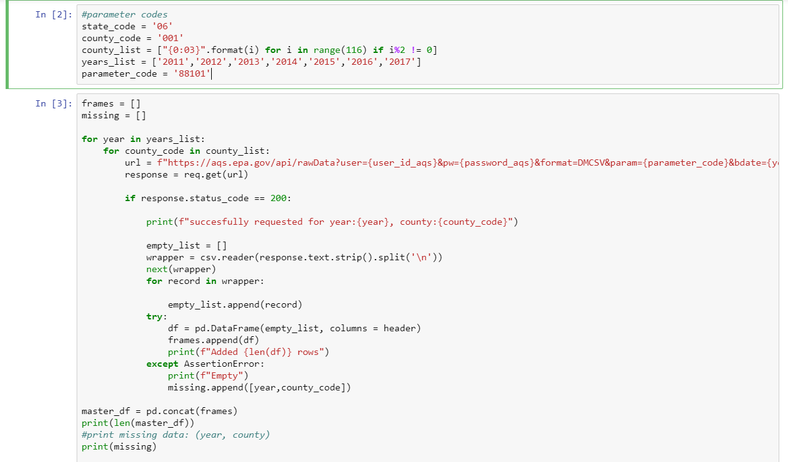
Notes:
Tropospheric ozone is a secondary pollutant, it is not emitted directly but instead is produced photochemically in the troposphere by its precursors such as reactive nitrogen oxide (NOx), CO, CH4 and VOC’s. Life time of an ozone molecule in the troposphere varies according to the photochemical activity ( a mean tropospheric life time is ~22days). Ozone has a longer life time in the free and cold troposphere than warmer boundary layer.
difference between stratospheric and tropospheric ozone generation is in the source of atomic O
for solar radiation with a wavelength of less than 242 nm:
O₂ + hv  O + O
photochemical production of O₃ in troposphere tied to NO_{x} (NO + NO₂)
for wavelengths less than 424 nm:
NO₂ + hv  NO + O
but NO will react with O₃
NO + O₃  NO₂
presence of peroxy radicals, from the oxidation of hydrocarbons, disturbs O₃-NO-NO₂ cycle
NO + HO₂·  NO₂ + OH·
NO + RO₂·  NO₂ + RO·
leads to net production of ozone
The ozone molecule has four resonance structure which imparts or confer a slight polarity to the ozone molecule (0.53D).
The bond length 1.272A is intermediate b/w double bond 1.21A and single bond (H-O) 1.47A {angstroms (A)}.
Protective shield in the stratosphere
Strong oxidant
Secondary pollutant in the troposphere
3rd most abundant GHG with RF +0.3 W.m-2
Damage crops and property
Cause respiratory diseases and premature mortality

Slide 3
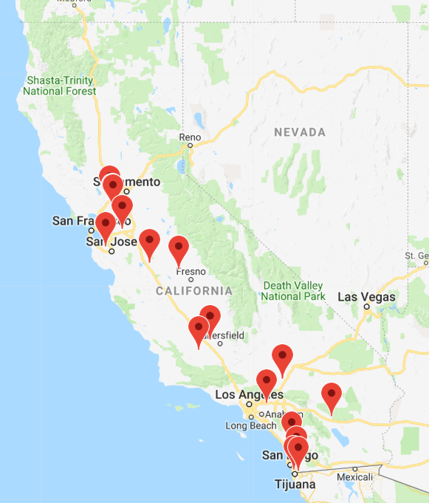
Green House Gas producing Facilities in CA
“In general, facilities that directly emit 25,000 metric tons
of carbon dioxide equivalent or more per year are required
to submit annual reports to EPA.”
-https://www.epa.gov/enviro/greenhouse-gas-overview
Notes:
Tropospheric ozone is a secondary pollutant, it is not emitted directly but instead is produced photochemically in the troposphere by its precursors such as reactive nitrogen oxide (NOx), CO, CH4 and VOC’s. Life time of an ozone molecule in the troposphere varies according to the photochemical activity ( a mean tropospheric life time is ~22days). Ozone has a longer life time in the free and cold troposphere than warmer boundary layer.
difference between stratospheric and tropospheric ozone generation is in the source of atomic O
for solar radiation with a wavelength of less than 242 nm:
O₂ + hv  O + O
photochemical production of O₃ in troposphere tied to NO_{x} (NO + NO₂)
for wavelengths less than 424 nm:
NO₂ + hv  NO + O
but NO will react with O₃
NO + O₃  NO₂
presence of peroxy radicals, from the oxidation of hydrocarbons, disturbs O₃-NO-NO₂ cycle
NO + HO₂·  NO₂ + OH·
NO + RO₂·  NO₂ + RO·
leads to net production of ozone
The ozone molecule has four resonance structure which imparts or confer a slight polarity to the ozone molecule (0.53D).
The bond length 1.272A is intermediate b/w double bond 1.21A and single bond (H-O) 1.47A {angstroms (A)}.
Protective shield in the stratosphere
Strong oxidant
Secondary pollutant in the troposphere
3rd most abundant GHG with RF +0.3 W.m-2
Damage crops and property
Cause respiratory diseases and premature mortality

